Slide 1
Node
By Komal Singh

Slide 2
N P M
npm makes it easy for JavaScript developers to share
and reuse code in the form of modules.
npm comes preinstalled with Node distributions.
npm runs through the command line and allows to
retrieve modules from the public package registry
maintained on http://npmjs.org
It is the fastest growing package manager:
http://www.modulecounts.com

Slide 3
The Node.js Event emitter
If you worked with JavaScript in the browser, you know how much of the interaction of the user is handled through events: mouse clicks, keyboard button presses, reacting to mouse movements, and so on.
On the backend side, Node.js offers us the option to build a similar system using the events module.
This module, in particular, offers the EventEmitter class, which we'll use to handle our events.
You initialize that using
const EventEmitter = require('node:events');
const eventEmitter = new EventEmitter();

Slide 4
This object exposes, among many others, the on and emit methods.
emit is used to trigger an event
on is used to add a callback function that's going to be executed when the event is triggered
For example, let's create a start event, and as a matter of providing a sample, we react to that by just logging to the console:
eventEmitter.on('start', () => { console.log('started');});

Slide 5
When we run
eventEmitter.emit('start');
the event handler function is triggered, and we get the console log.
You can pass arguments to the event handler by passing them as additional arguments to emit():
eventEmitter.on('start', number => {
console.log(`started ${number}`);
});
eventEmitter.emit('start', 23);

Slide 6
Multiple arguments:
eventEmitter.on('start', (start, end) =>
{ console.log(`started from ${start} to ${end}`);
});
eventEmitter.emit('start', 1, 100);

Slide 7
The EventEmitter object also exposes several other methods to interact with events, like
once(): add a one-time listener
removeListener() / off(): remove an event listener from an event
removeAllListeners(): remove all listeners for an event

Slide 8
What is the Event Loop?
The event loop is what allows Node.js to perform non-blocking I/O operations — despite the fact that JavaScript is single-threaded — by offloading operations to the system kernel whenever possible.
Event Loop Explained
When Node.js starts, it initializes the event loop, processes the provided input script (or drops into the REPL, which is not covered in this document) which may make async API calls, schedule timers, or call process.nextTick(), then begins processing the event loop

Slide 9
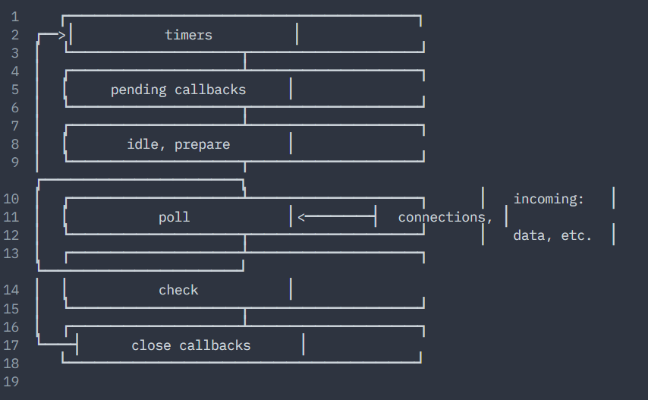
The following diagram shows a simplified overview of the event loop's order of operations.

Slide 10
Phases Overview
timers: this phase executes callbacks scheduled by setTimeout() and setInterval().
pending callbacks: executes I/O callbacks deferred to the next loop iteration.
idle, prepare: only used internally.
poll: retrieve new I/O events; execute I/O related callbacks (almost all with the exception of close callbacks, the ones scheduled by timers, and setImmediate()); node will block here when appropriate.
check: setImmediate() callbacks are invoked here.
close callbacks: some close callbacks, e.g. socket.on('close', ...).

Slide 11
Overview of Blocking vs Non-Blocking
This overview covers the difference between blocking and non-blocking calls in Node.js.
This overview will refer to the event loop and libuv but no prior knowledge of those topics is required. Readers are assumed to have a basic understanding of the JavaScript language and Node.js callback pattern.
Blocking
Blocking is when the execution of additional JavaScript in the Node.js process must wait until a non-JavaScript operation completes.
This happens because the event loop is unable to continue running JavaScript while a blocking operation is occurring.

Slide 12
In Node.js, JavaScript that exhibits poor performance due to being CPU intensive rather than waiting on a non-JavaScript operation, such as I/O, isn't typically referred to as blocking. Synchronous methods in the Node.js standard library that use libuv are the most commonly used blocking operations.
Native modules may also have blocking methods.
All of the I/O methods in the Node.js standard library provide asynchronous versions, which are non-blocking, and accept callback functions. Some methods also have blocking counterparts, which have names that end with Sync.

Slide 13
Non-Blocking:
It refers to the program that does not block the execution of further operations. Non-Blocking methods are executed asynchronously. Asynchronously means that the program may not necessarily execute line by line.
The program calls the function and move to the next operation and does not wait for it to return.
Example: Following example uses the readFile() function to read files and demonstrate Non-Blocking in Node.js

